Slide 1



DATA TRANSFORMATION

Slide 2

AGENDA
What is Data Transformation
CASE Statement
CAST Function
Window Functions
User Defined Functions

Slide 3
What is Data Transformation?

Slide 4
DEFINITION OF DATA TRANSFORMATION
The process of converting data from one format or structure to another, making it more suitable for analysis, reporting, or further processing
Some examples:
Converting time zones
Address standardization
Combining survey data with different formats
Hashing / encrypting sensitive data

Slide 5
IMPORTANCE OF DATA TRANSFORMATION
Clean and organize data: ensure data quality and consistency
Improve compatibility: enable compatibility across different systems and databases
Normalize data: reduce redundancy and achieve data integrity

Slide 6
CASE Statement

Slide 7
CASE STATEMENT SYNTAX
The CASE statement is a conditional expression in SQL, used to create a new column in the result table based on specific conditions
CASE
WHEN condition_1 THEN desired_output_1
WHEN condition_2 THEN desired_output_2
WHEN condition_2 THEN desired_output_2
…
…
ELSE desired_output_n
END [AS new_column_name]

Slide 8
CASE STATEMENT EXAMPLES
Age groups: classify people into age groups (e.g., ‘Child’, ‘Teen’, ‘Adult’, ‘Senior’)
Discount: calculate discount for based on total purchase amount (e.g., 5% for purchases over $500, 10% for purchases over $1,000, etc.)
Academic grades: convert numeric exam scores into letter grades (e.g., A, B, C, D, F)

Slide 9
CASE STATEMENT EXAMPLES
In the order_details table, classify each row based on their quantity: 'large' (>40), 'medium' (<=40 and >20), or 'small' (<=20)
Show every row from order_details that has no discount and quantity <10 or if there is a discount, the quantity must be between 10 and 20

Slide 10
Type Transformation Using CAST

Slide 11
CAST FUNCTION SYNTAX
CAST is a SQL function that explicitly converts an expression of one data type to another
CAST (column_name AS new_datatype) [AS alias]
or
column_name::new_datatype [AS alias]

Slide 12
COMMON DATA TYPES
VARCHAR ↔ TEXT
INTEGER ↔ FLOAT
BOOLEAN
DATE ↔ TIMESTAMP

Slide 13
CAST FUNCTION EXAMPLES
In the orders table, convert orderdate to string
In the products table, show unitsinstock as a percentage of the grand total unitsinstock

Slide 14
Window Functions

Slide 15
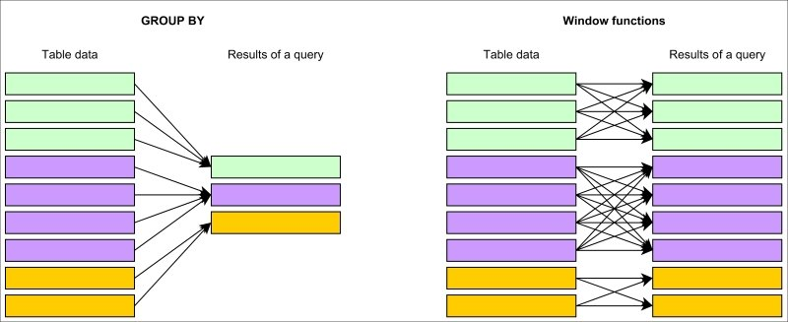
DEFINITION OF WINDOW FUNCTIONS
Window functions perform calculations across a set of table rows related to the current row, returning a single value for each row in the result set

Slide 16
WINDOW FUNCTIONS SYNTAX
Advanced calculations and data manipulation, enabling insights that would be difficult or inefficient to obtain using standard aggregate functions
WINDOW_FUNCTION (arg1, arg2, …)
OVER (
PARTITION BY column1
ORDER BY column2
)

Slide 17
WINDOW FUNCTIONS — COMPONENTS
OVER(): defines the window or range of rows to be considered for the calculation
PARTITION BY: divides the result set into partitions to which the window function is applied
ORDER BY: specifies the order in which the rows in the partition are processed by the window function

Slide 18
Break Time!
Notes:
Timer works with extension “Slides Timer”

Slide 19
WINDOW FUNCTIONS — RANKING
ROW_NUMBER(): assigns a unique, sequential integer to each row within the result set
RANK(): ranks each row within the result set, leaves gaps when there are equal rank values
DENSE_RANK(): ranks each row within the result set, does not leave gaps
PERCENT_RANK(): calculates the relative rank as a percentage, ranging from 0 to 1

Slide 20
WINDOW FUNCTIONS — AGGREGATES
SUM(): sum of a column's values over the specified window
AVG(): average of a column's values over the specified window
MIN(): smallest value over the specified window
MAX(): largest value over the specified window
COUNT(): number of rows in the specified window

Slide 21
WINDOW FUNCTIONS — NAVIGATION
FIRST_VALUE(): first value in the window
LAST_VALUE(): last value in the window
NTH_VALUE(): n-th value in the window
LEAD(): value for the row that is n rows ahead of the current row
LAG(): value for the row that is n rows behind the current row

Slide 22
WINDOW FUNCTIONS — DISTRIBUTION
CUME_DIST(): cumulative distribution of a value in the specified window, returns a relative value between 0 and 1
NTILE(n): divides the result set into n approximately equal buckets, assigns a bucket number to each row

Slide 23
User Defined Functions

Slide 24
USER DEFINED FUNCTIONS SYNTAX
Custom functions created by the user to perform specific tasks that may not be readily available or easily achievable using built-in functions
CREATE OR REPLACE FUNCTION function_name (arg1 DATATYPE, arg2 DATATYPE, …)
RETURNS DATATYPE AS $$
{FUNCTION BODY}
$$ LANGUAGE plpgsql;

Slide 25
EXAMPLE OF A FUNCTION
CREATE OR REPLACE FUNCTION calc_total_price (input_orderid INTEGER)
RETURNS NUMERIC AS $$
DECLARE
total_price NUMERIC := 0;
BEGIN
SELECT SUM(unitprice * quantity * (1 - discount))
INTO total_price
FROM order_details
WHERE orderid = input_orderid;
RETURN total_price;
END;
$$ LANGUAGE plpgsql;

Slide 26
EXAMPLE OF A FUNCTION
SELECT orderid, calc_total_price(orderid) AS total_price
FROM orders

Slide 27
SQL Exercises

Slide 28
EXERCISES
Assign a 'Low', 'Medium', or 'High' price label to each product based on its unit price.
Classify customers as 'Local' or 'International' based on their country.
Assign a discount category to each order based on the average discount applied to its order details.
Convert the order date to a string.
Calculate the VAT (Value Added Tax) for each product's unit price assuming a VAT rate of 20%. (HARD)
BONUS: Round the result to 2 decimal places.
Calculate the total price of each order, including VAT, and format the result as a string with a currency symbol. (HARD)
Assign a row number to each product based on its unit price in ascending order.
Rank employees by the total number of orders they have managed. (HARD)
Assign a dense rank to customers based on the total revenue they have generated. (HARD)
Assign a row number to each product within its category based on its unit price in ascending order.
Take a look at the Other Window Functions, experiment on some queries, share your results with your peers in the discord. Explain the insight of that query or how it can be useful. (Build 2-3 unique queries) (HARD + CREATIVE)

